Slide 1

ArcGIS API for JavaScript: Creating Custom Layers and Layer Views
Jacob Wasilkowski @JWasilGeo
Services Enablement Workshop 2021

Slide 2




Going Beyond the JSAPI Layer
Images and Tiles
BaseDynamicLayer
BaseElevationLayer
2D Graphics
3D Graphics
BaseTileLayer
externalRenderers
BaseLayerView2D
BaseLayerViewGL2D
Choose your adventure!
Preprocess images
Manipulate elevations
Connect to a unique service(s)
…OR YOU COULD…
Draw your own 2D or 3D graphics
Bring your dreams to life with Canvas or WebGL

Slide 3
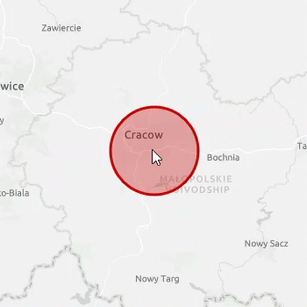
Hello World!
A custom and animated BaseLayerView2D
Review a simple GraphicsLayer
Compare with a BaseLayerView2D
Animate it!
https://github.com/jwasilgeo/esri-experiments

Slide 4
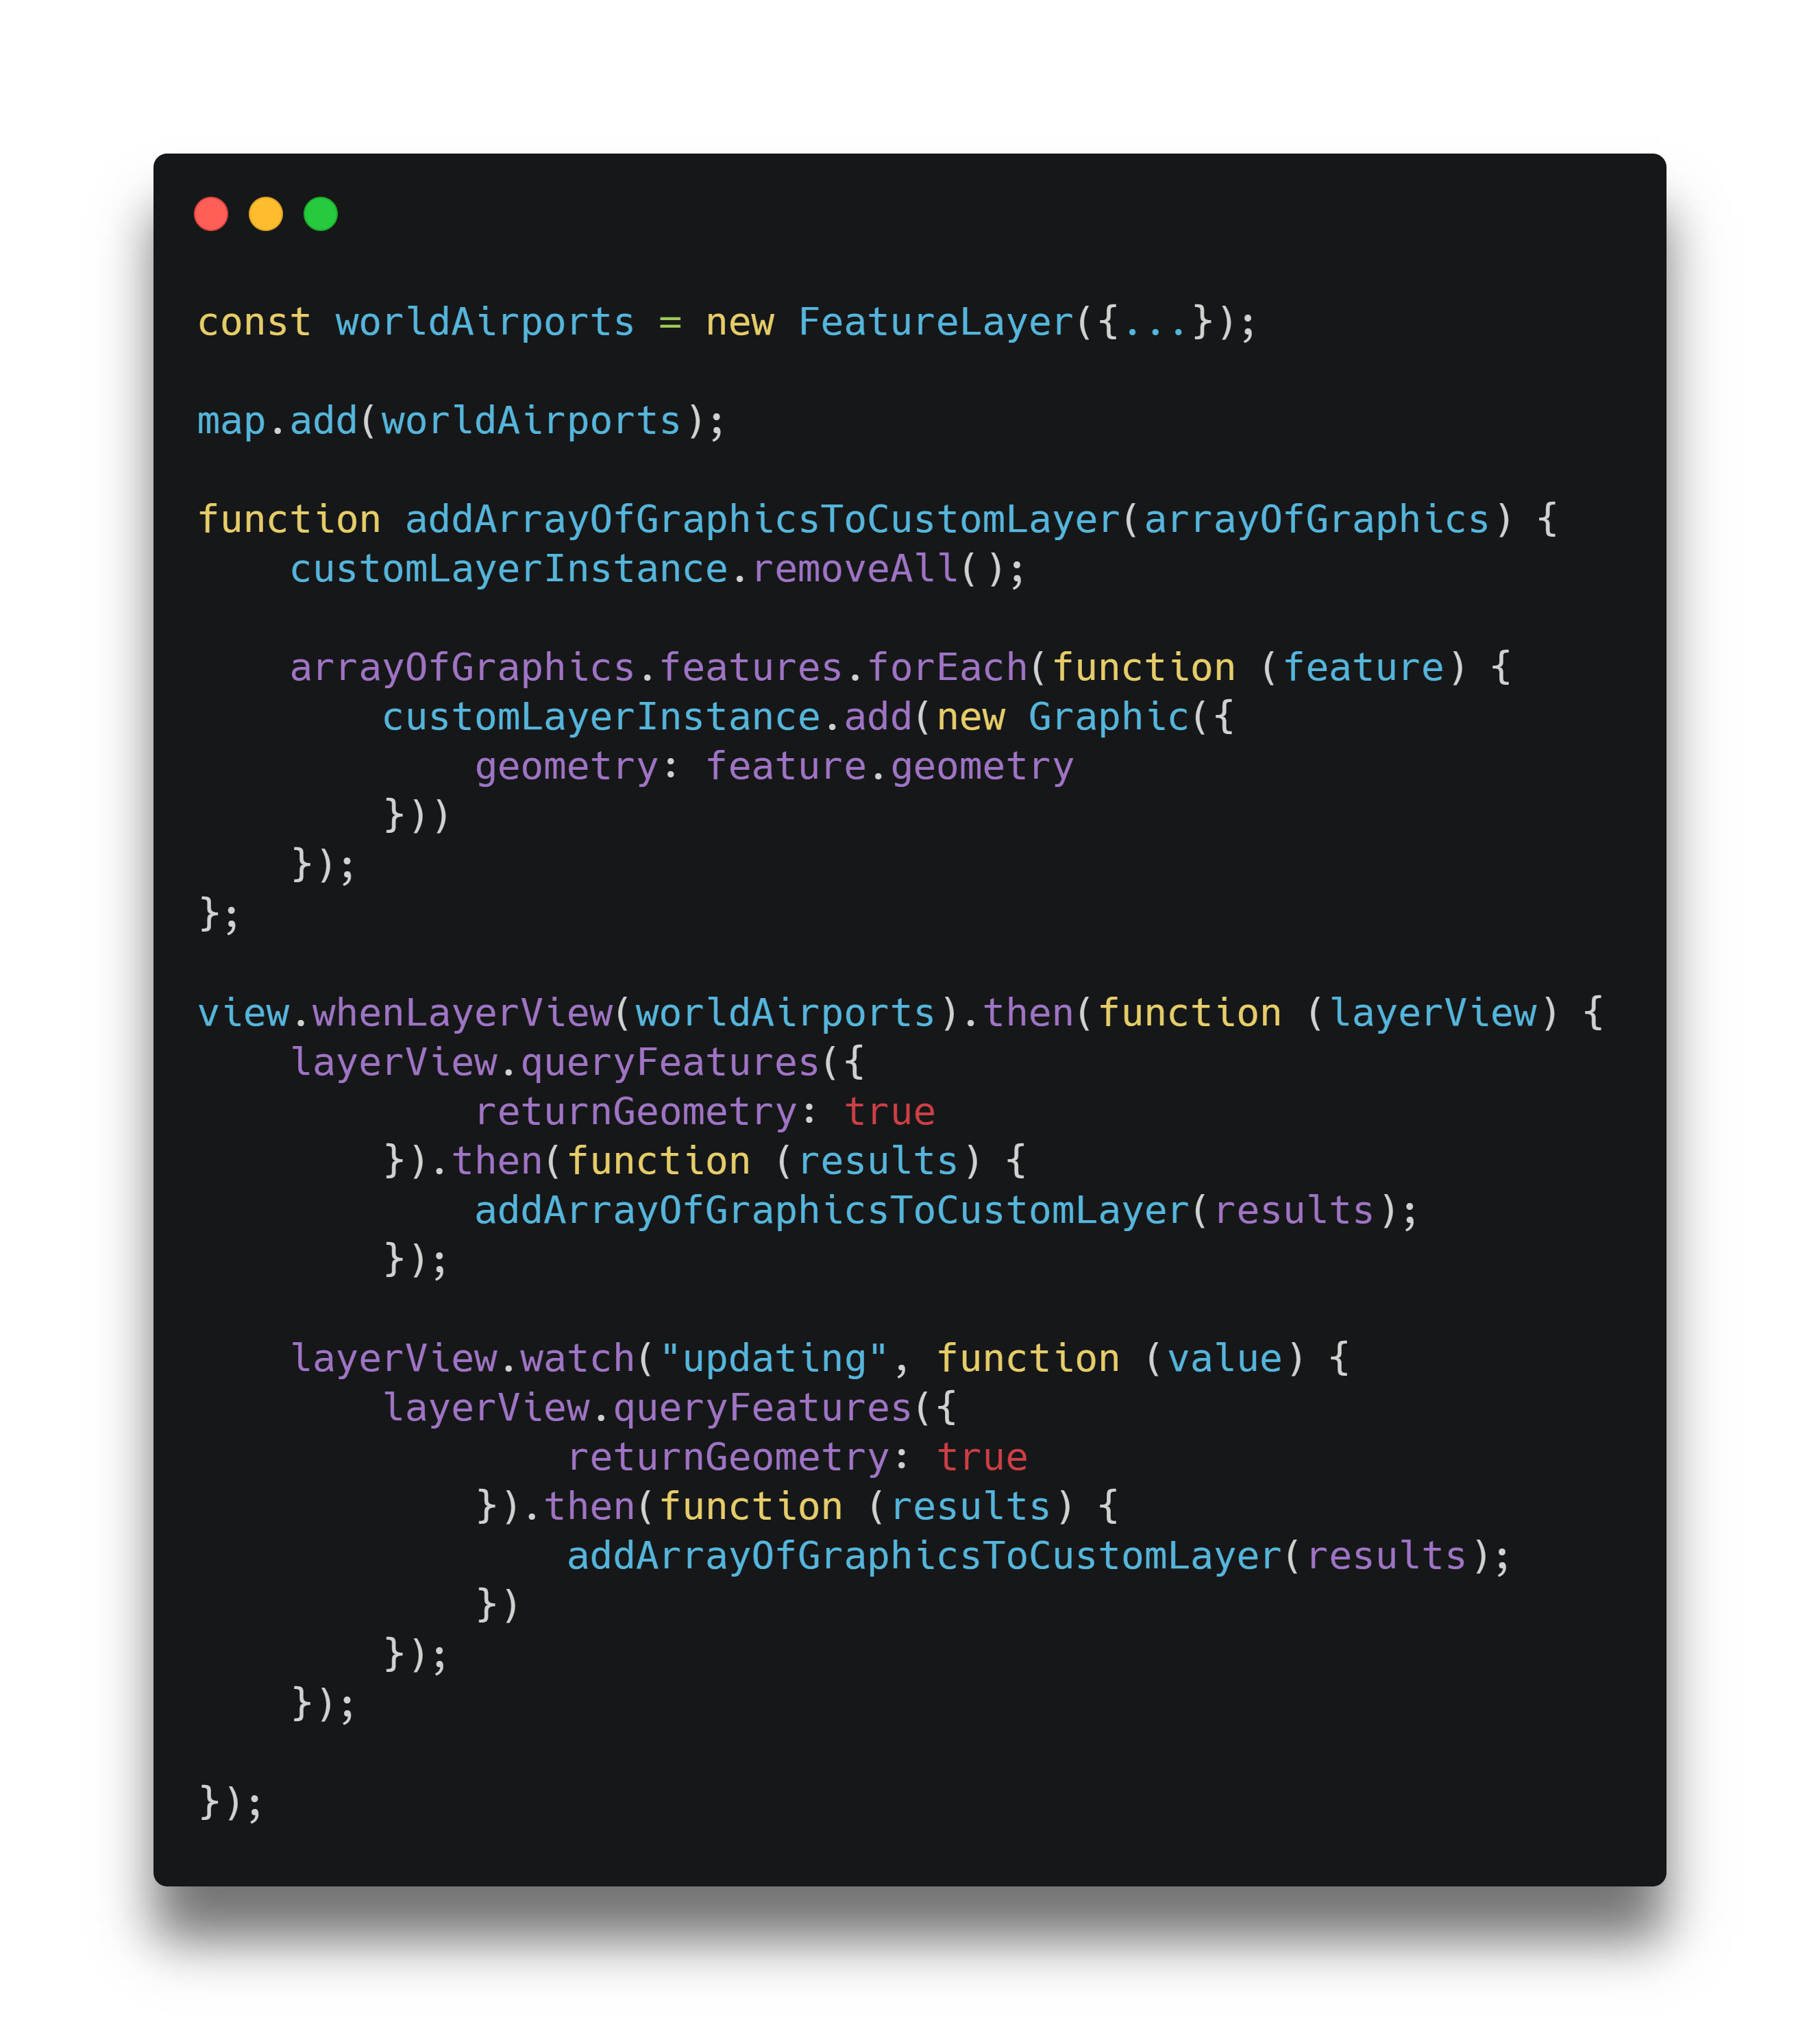
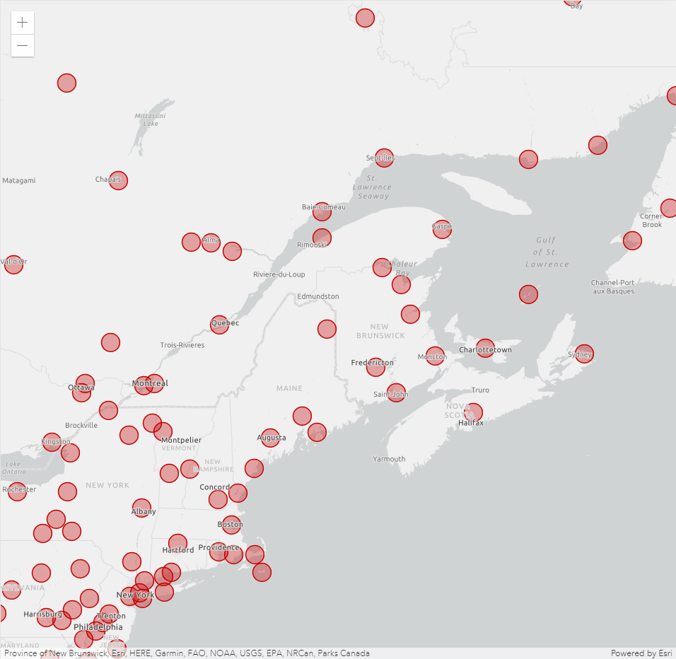
Custom Layer from Feature Layer – Animated points
Sean McGee @HertsWestUK
https://codepen.io/hertswestuk/pen/mdOENve

Slide 5
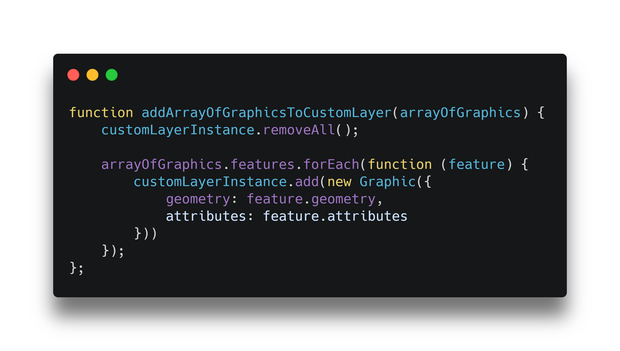
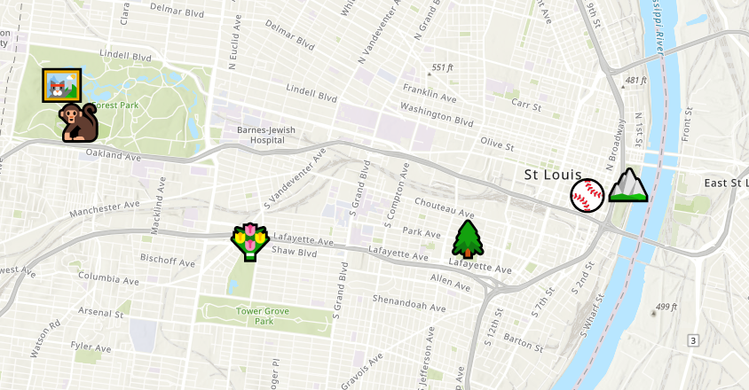
Custom Layer from Feature Layer – Accessing attribute data
Gavin Rehkemper @gavinrehkemper
gavinr.github.io/emoji-map-layer

Slide 6
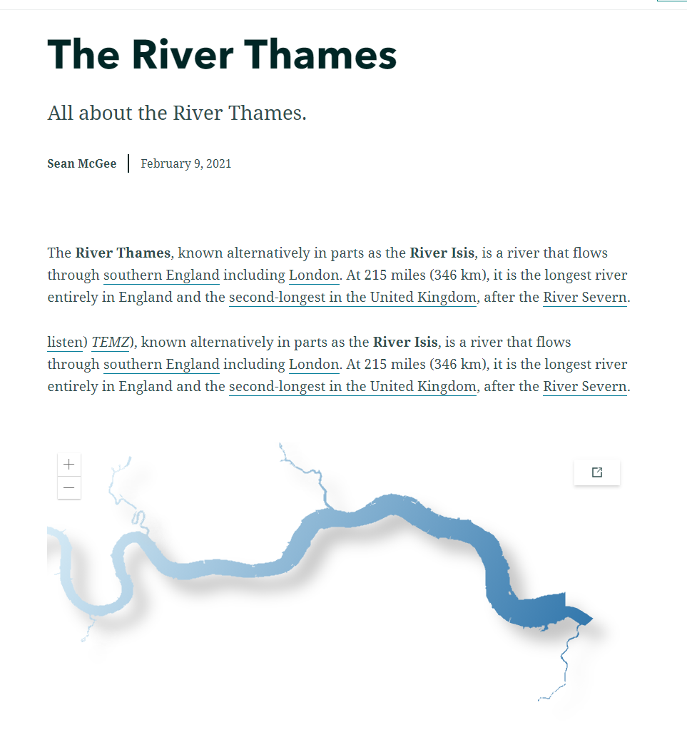
Demo
Using canvas stylings made by Sean McGee
codepen.io/hertswestuk/pen/LYbZwvK

Slide 7

Utilizing Canvas

Slide 8
Blending sample
2 overlapping square symbols with a solid colour (yellow and red).
Yellow
Red
Yellow
Red
No blend option
Symbol blend option enabled

Slide 9
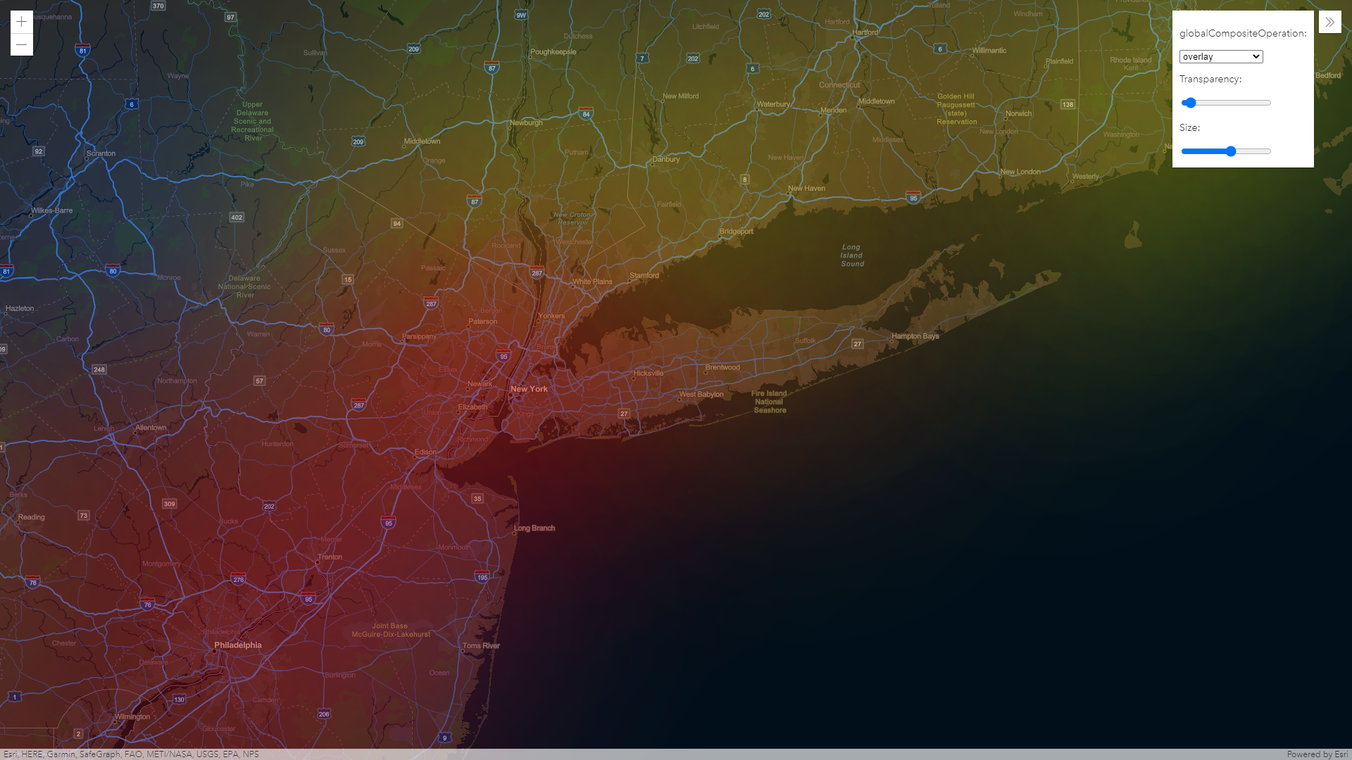
Demo
Using canvas blending made by Sean McGee
https://github.com/smcgee2/EsriJS_CustomLayer_WeatherSample

Slide 10
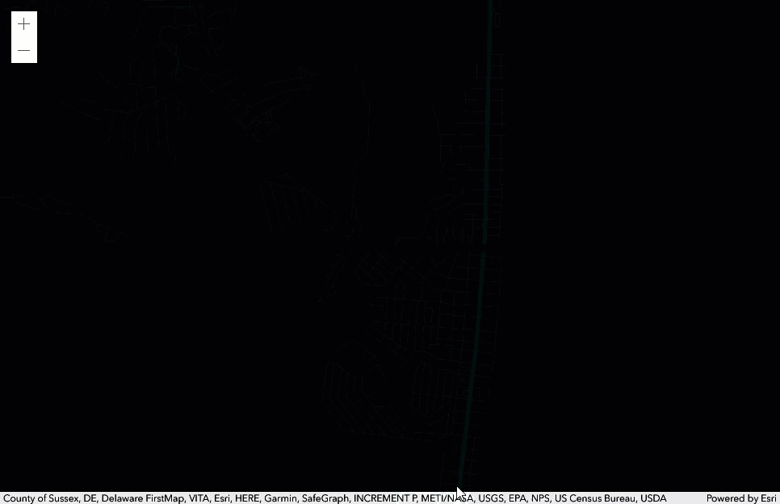
Demo
A custom BaseLayerView2D made by Sean McGee
https://codepen.io/smcgee/pen/KKpKPxW

Slide 11
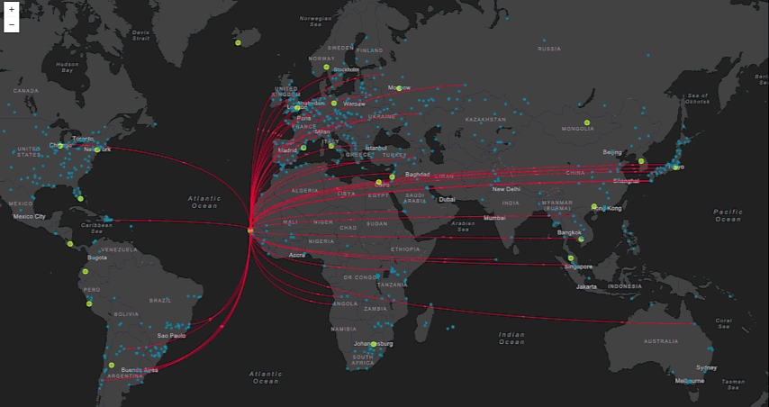
Demo
“Canvas-Flowmap-Layer”
A custom BaseLayerView2D made by Sarah Bell and Jacob Wasilkowski
@sarahbellmaps
https://github.com/sarahbellum/Canvas-Flowmap-Layer

Slide 12
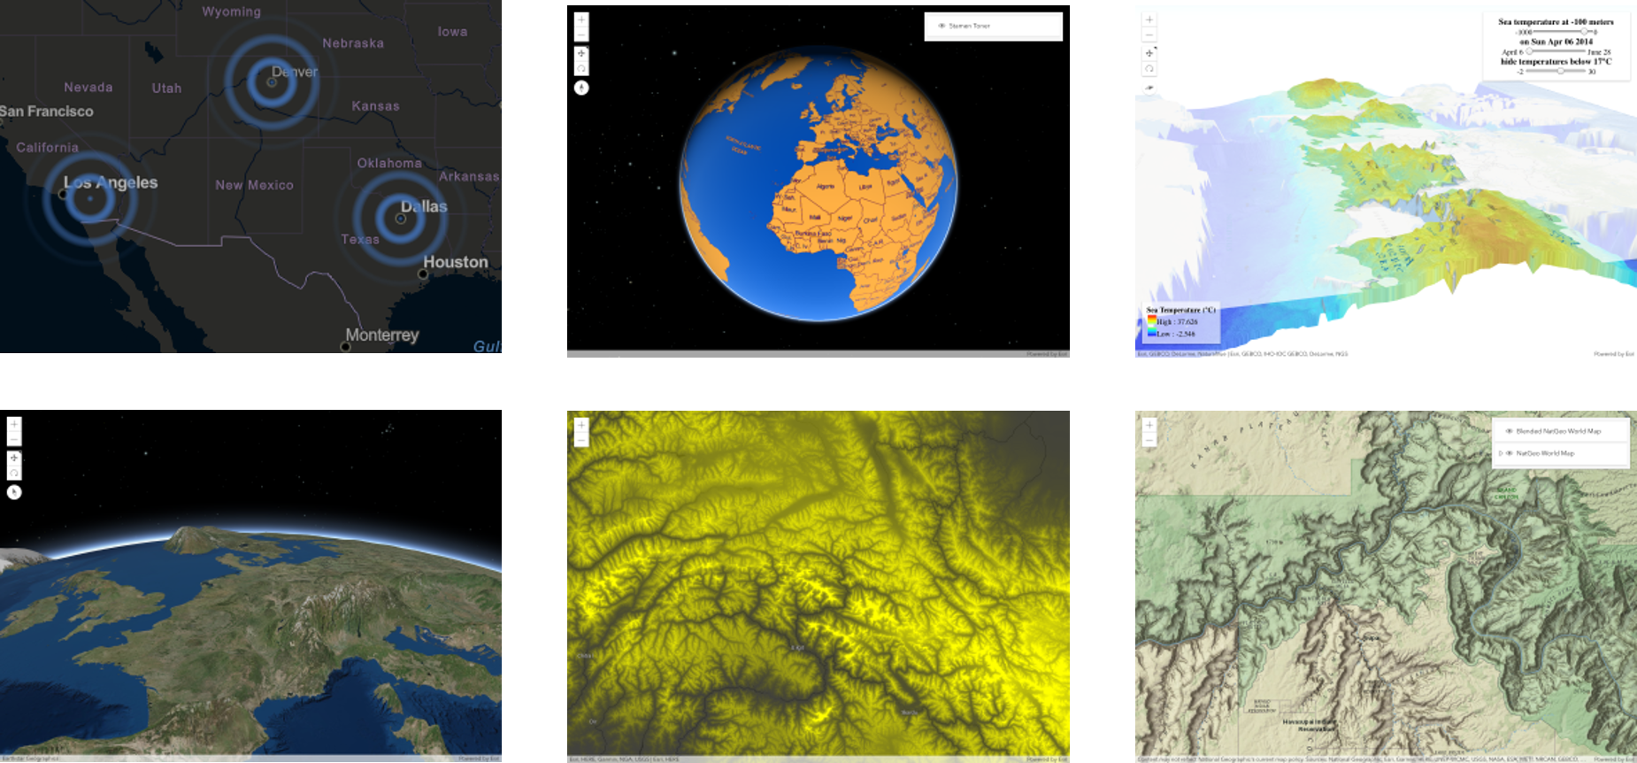
JSAPI Examples of What’s Possible: https://esriurl.com/jsCustomLayers

Slide 13
Resources
These slides are available at
https://github.com/jwasilgeo/presentations
Dev Summit 2021
https://youtu.be/HFDdLI3aIVg
Dev Summit 2019
https://proceedings.esri.com/library/userconf/devsummit19/papers/DevSummitPS_10.pdf
Dev Summit 2018
https://proceedings.esri.com/library/userconf/devsummit18/papers/dev-int-018.pdf

Slide 14
Thank you!
Jacob Wasilkowski
@JWasilGeo

